Slide 1


Getting Started with IoT using Arduino
By
Joel Ssematimba & Priscilla Adong
Department of Computer Science,Makerere University,
Kampala, Uganda.

Slide 2
Lab session: IoT for air quality monitoring
Goal:
to build an air quality monitor using low-cost sensors. The monitor consists of sensors which detect temperature and humidity and the level of PM2.5 in the air and sends this information to a cloud platform (Thingspeak) via a Wi-Fi module (ESP8266).

Slide 3
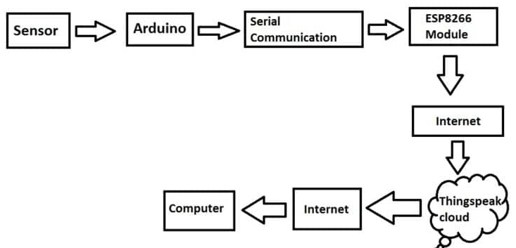
System Architecture

Slide 4
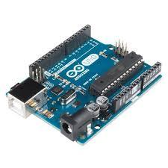
Hardware Components
Arduino UNO

Slide 5
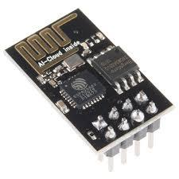
Hardware Components
Wi-Fi module (ESP8866)
Notes:
Units of measure: Having different types of sensors, some record in Fahrenheit while others in Celsius so this comes back to the point of uniformity made earlier

Slide 6
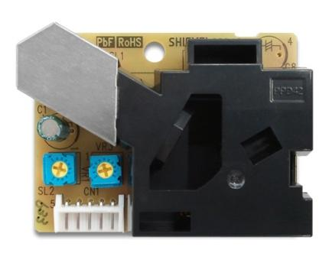
Hardware Components
Shenyei PPD42NJ
PM sensor
Notes:
Aims at understanding data by extracting and graphing information to show patterns and trends.

Slide 7
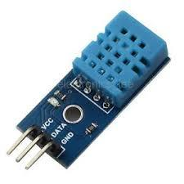
Hardware Components
Dht11
Temperature and Humidity Sensor
Notes:
Aims at understanding data by extracting and graphing information to show patterns and trends.

Slide 8
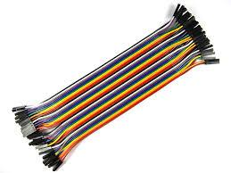
Hardware Components
Jumper wires
Notes:
Aims at understanding data by extracting and graphing information to show patterns and trends.

Slide 9
IoT Cloud Platform
An IoT cloud platform receives data from sensors where it is stored for analysis.
We use ThingSpeak as our IoT cloud platform. Other platforms include Google IoT core, AWS IoT core, Azure IoT Hub, etc.

Slide 10
Connecting the components
Esp8266 | Arduino — — — — — — — — - RX | 9 TX | 8 GND | GND (same) VCC | 5v (same) CH_PD | 5v (same) GPIO 0 | None (same) GPIO 2 | None (same)
DHT 11 | Arduino
-------------------------
Data | A0
GND | GND (same)
VCC | 5V
PM Sensor | Arduino
-------------------------

Slide 11
Programming Session
What you will need:-
A ThingSpeak Account: Our cloud platform
Arduino IDE:Used to write and upload programs to Arduino compatible boards.
DHT 11 library: To read from DHT 11 sensors

Slide 12
Sending data to the cloud platform
Command “AT”
This is a test command to ensure proper communication between the DTE and DCE.
DTE(Data Terminal Equipment)
Command “AT+RST”
This is used to reset the DCE device.
RES “Generic information”
Command “AT+CIPSHUT”
This is used to shut any current connections
RES “SHUT OK”

Slide 13
Sending data to the cloud platform
4. Command “AT+CWMODE=1”
WIFI mode（station/softAP/station+softAP）
1 means Station mode
2 means AP mode
3 means AP + Station mode
RES “OK”

Slide 14
Sending data to the cloud platform
5. Command “AT+CWJAP”
Parameter description： ssid： string, AP’s SSID pwd： string, MAX: 64 bytes
Example： AT+CWJAP="wifi-1","12345678"
RES “Connected”

Slide 15
Sending data to the cloud platform
6. Command “AT+CIFSR”
Parameter description： IP_address: IP address of ESP8266 softAP IP address of ESP8266 station
RES “IP address”
7. AT+CIPSTART="TCP","184.106.153.149",80
8. AT+CIPSEND=44
9. GET /update?key= S81QKAFKPGRR7LK8 &field1=96

Slide 16
Homework
The task and challenge we leave to you is to have the above programmatically working and sending values without input.

